Slide 1
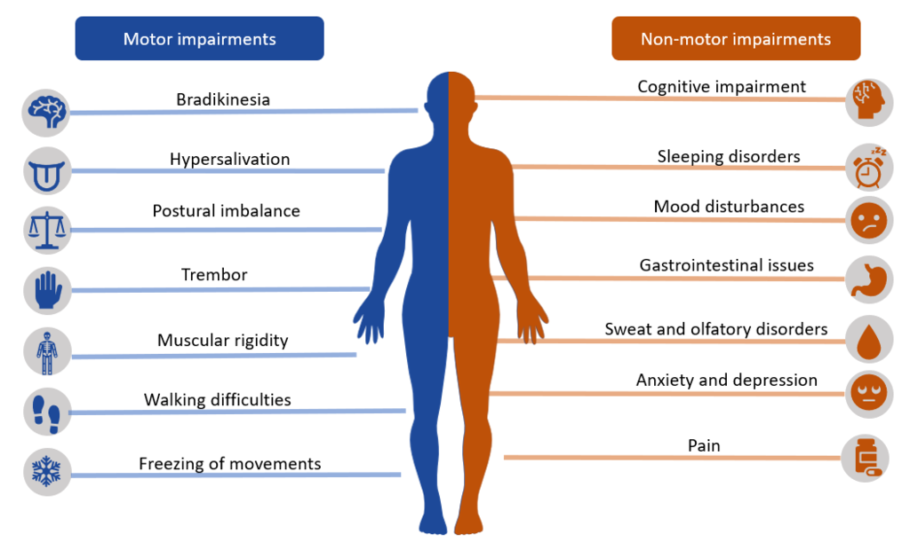
DETECTION OF PARKINSON DISEASE USING MACHINE LEARNING

Slide 2
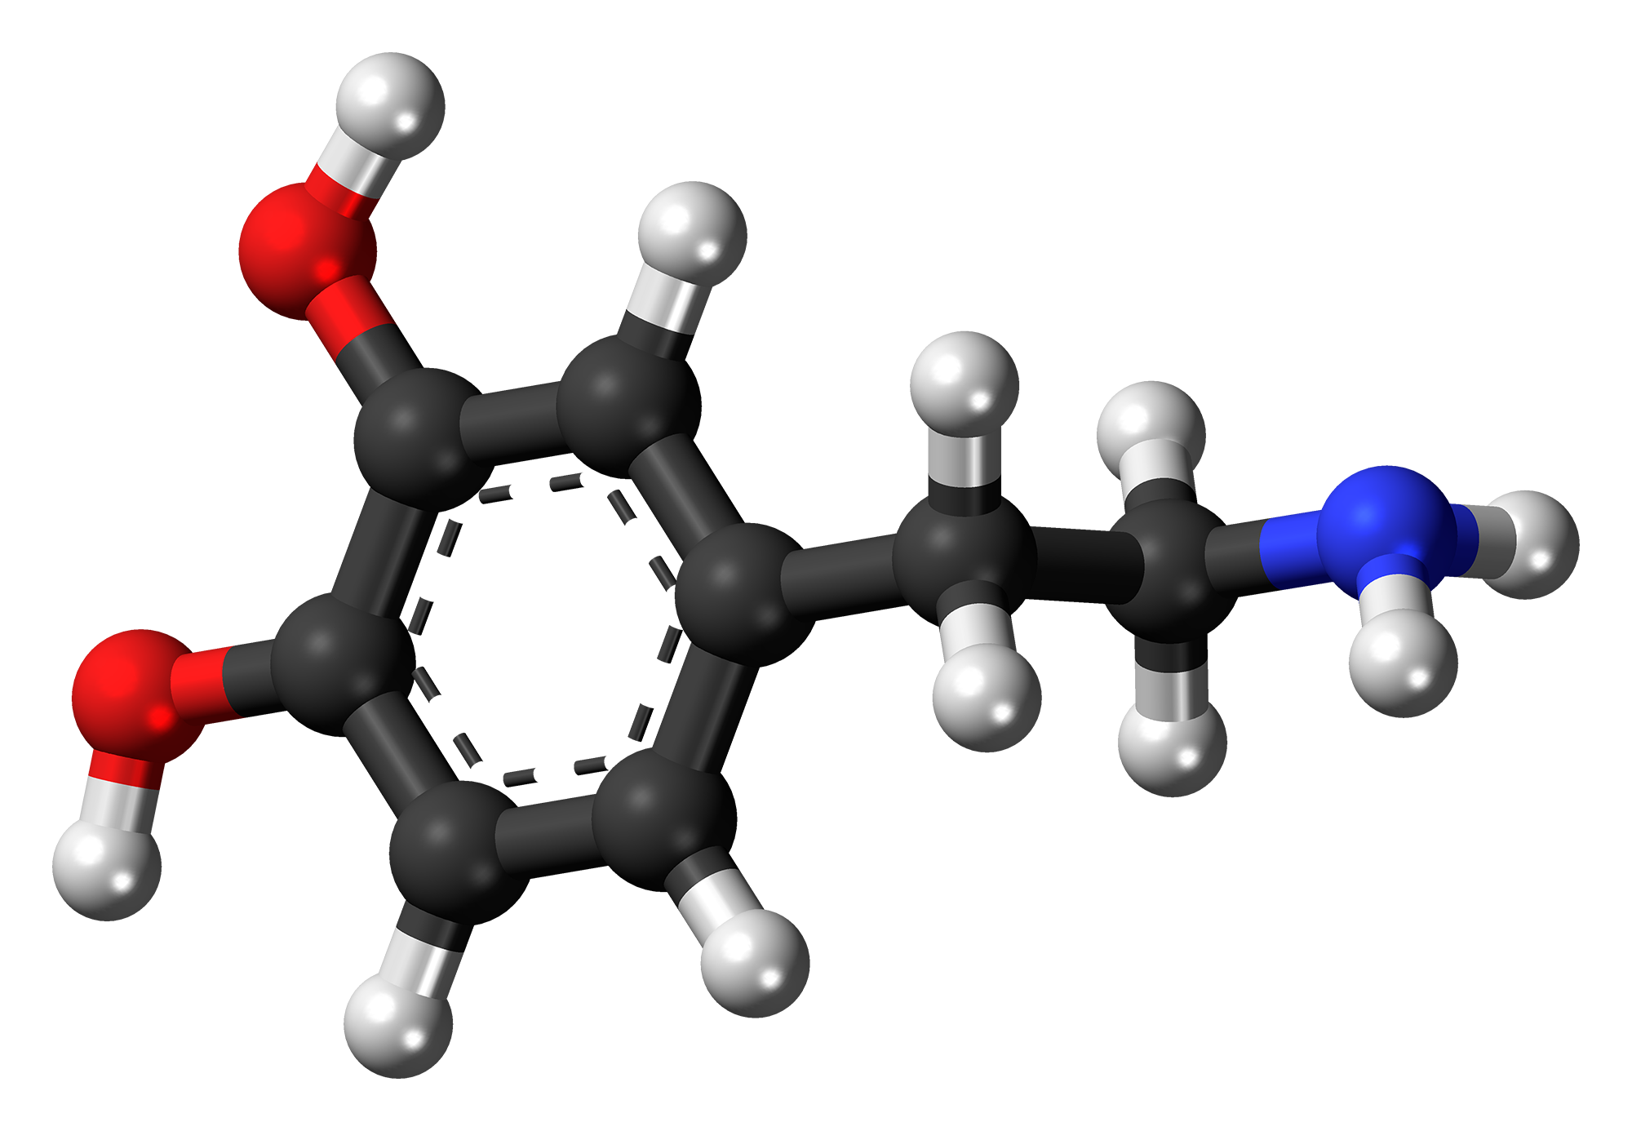
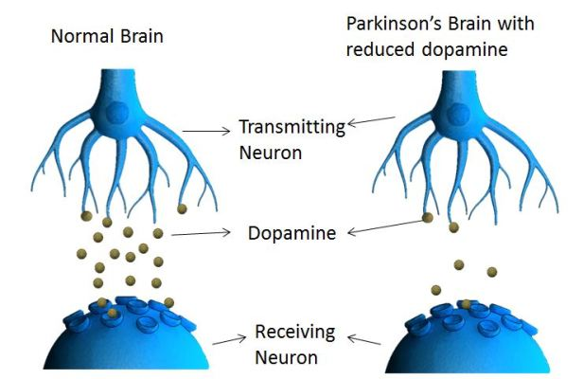
WHAT IS PARKINSON DISEASE?
It is a progressive neurological disorder
Its main cause is lack of production of Dopamine hormone in our brain.
Parkinson is non curable disease but early detection could help in controlling the disease.

Slide 3
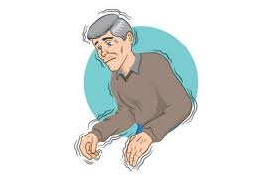
SYMPTOMS OF PARKINSON’S DISEASE:
Tremor (trembling) in hands, arms, legs, jaw, or head.
Stiffness of the limbs and trunk.
Slowness of movement.
Impaired balance and coordination, sometimes leading to falls
Shimmering of voice..

Slide 4

OUR APPROACH
PARKINSON DETECTION
VOICE ANALYSIS
1.Feature extraction
2.Model training.
3.Model prediction

Slide 5
EXTRACTED FEATURES FROM SPEECH RECORDINGS:
ABBREVIATIONS | FEATURE DESCRIPTION
MDVP:FO | Average vocal fundamental frequency
MDVP:Fhi | Maximum vocal fundamental frequency
MDVP:Flo | Minimum vocal fundamental frequency
MDVP:Jitter(%) | MDVP jitter in percentage
MDVP:Jitter(Abs) | MDVP absolute jitter in ms
MDVP:RAP | MDVP relative amplitude perturbation
MDVP:PPQ | MDVP five-point period perturbation quotient
Jitter:DDP | Average absolute difference of differences between jitter cycles
ABBREVIATIONS | FEATURE DESCRIPTION
MDVP:Shimmer | MDVP local shimmer
MDVP:Shimmer(dB) | MDVP local shimmer in dB
Shimmer:APQ3 | Three-point amplitude perturbation quotient
Shimmer:APQ5 | Five-point amplitude perturbation quotient
MDVP : APQ11 | MDVP 11-point amplitude perturbation quotient
Shimmer:DDA | Average absolute differences between the amplitude
NHR | Noise to harmonics ratio
HNR | Harmonics to noise ratio

Slide 6
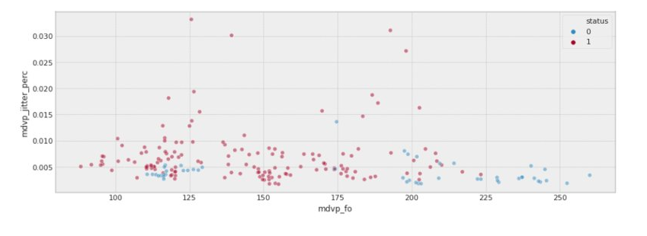
From the above plot ,we can see that the people without Parkinson's have their fundamental frequencies that is either high or very low and the percentage of jitter is usually lower than 0.005%.

Slide 7
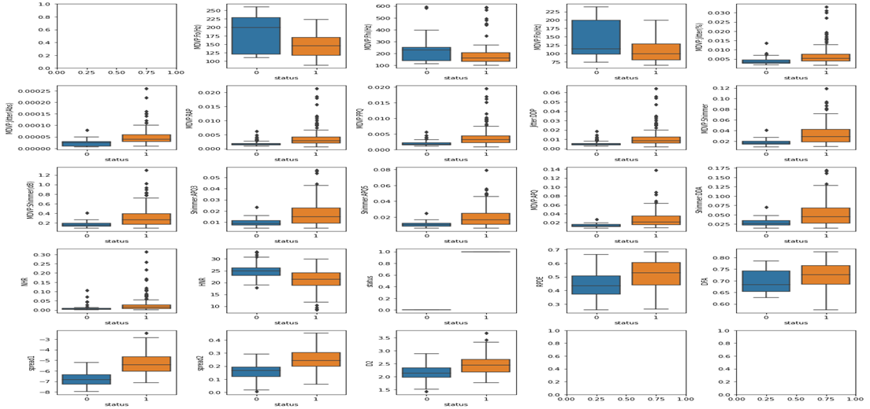
GRAPHICAL REPRESENTATION

Slide 8
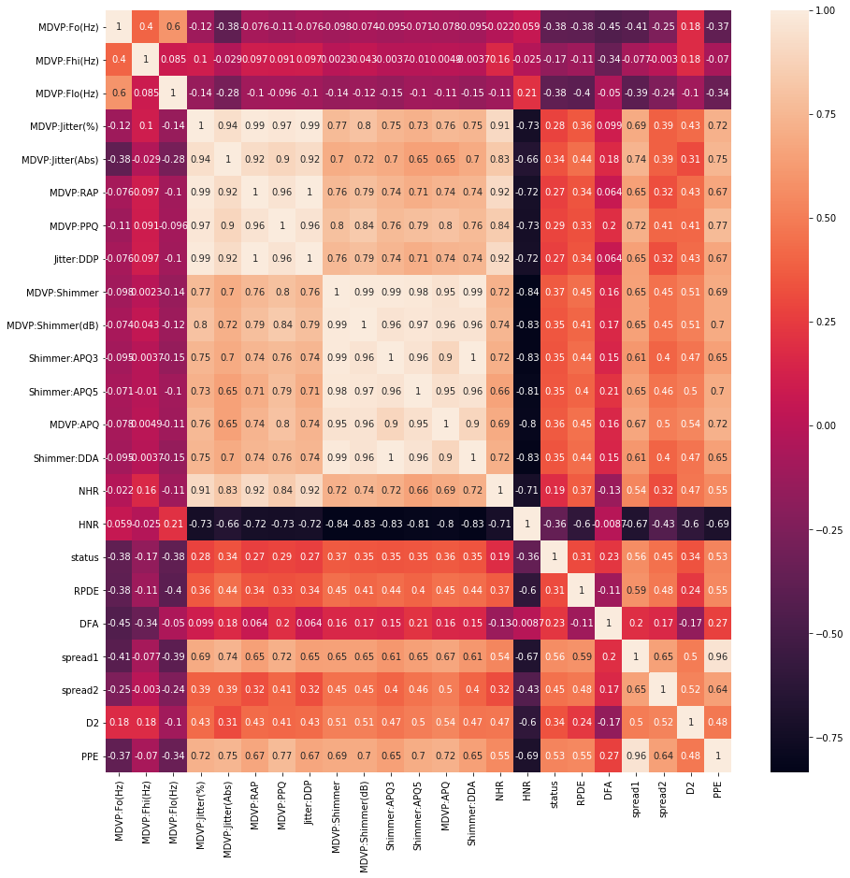
CORRELATION MATRIX

Slide 9
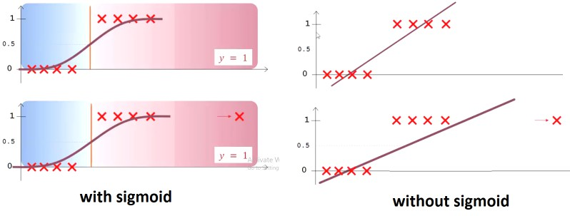
LOGISTIC REGRESSION
WHY NOT LOGISTIC REGRESSION ?
Logistic regression classifies by drawing a linear boundary hence it is seldom used for real world scenario where nonlinear classification boundary is required.
Large number of features.
ACCURACY - 89.23%

Slide 10
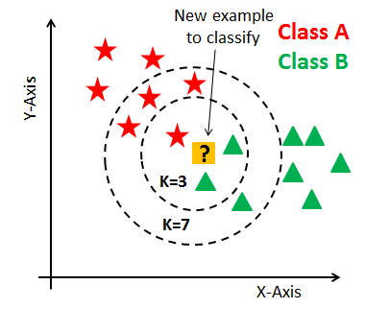
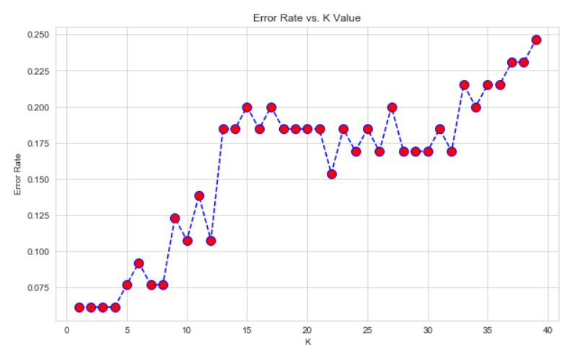
KNN
WHY NOT K NEAREST NEIGHBOUR ?
If dataset increased then it would give high computational overhead.
It assumes and gives equal importance to all features which is not suitable for our result.
ACCURACY – 90.7%

Slide 11
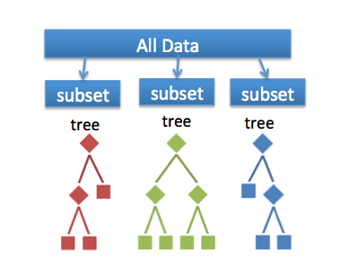
RANDOM FOREST
WHY NOT RANDOM FOREST ?
As in this model all are independent decision trees , so there is no chance of self learning for more appropriate detection.
ACCURACY -86.15%

Slide 12
XGBoost
Sequentially combines multiple models:
Weak learner model (1)
Weak learner model (2)
Weak learner model (N)
F(i)=F(i-1)+f(i)
F(i) is current model, F(i-1) is previous model and small f(i) represents a weak model
For any incorrect prediction, larger weights are assigned to misclassified samples and lower ones to samples that are correctly classified.
ACCURACY - 92.307%

Slide 13
ADVANTAGES OF XGBOOST
Accuracy of the model is increased by combining multiple weak learners.
(Accuracy = 92.307%).
Less computation steps are required for training of the model.
Tree pruning: Nodes which does not contribute much for the classification of leaf nodes are removed.
Parallelization: It divides the data into blocks which are parallelly assigned to multiple threads for optimized usage of CPU.

Slide 14
HOW WE DECIDED OUR MODEL ?
CROSS VALIDATION SCORES:
LOGISTIC REGRESSION - 86.5
RANDOM FOREST - 88.74
XG BOOST - 91.02
TESTING DATA
TRAINING DATA
Hyper parameter:
[objective ='binary:hinge', colsample_bytree = 0.3, learning_rate=0.3, max_depth = 5, alpha = 10, n_estimators = 10]

Slide 15
MODEL FLOW DESIGN FOR DETECTION USING VOICE DATASET
CLASSIFICATION ALGORITHMS
PD DATASET
LOGISTIC REGRESSION - 89.23%
K NEAREST NEIGHBOUR - 90.7%
RANDOM FOREST - 86.15%
XGBoost - 92.307%
DATA ANALYSIS
MODEL TRAINING
EVALUATION
FEATURE SELECTION
SPLIT DATASET

Slide 16
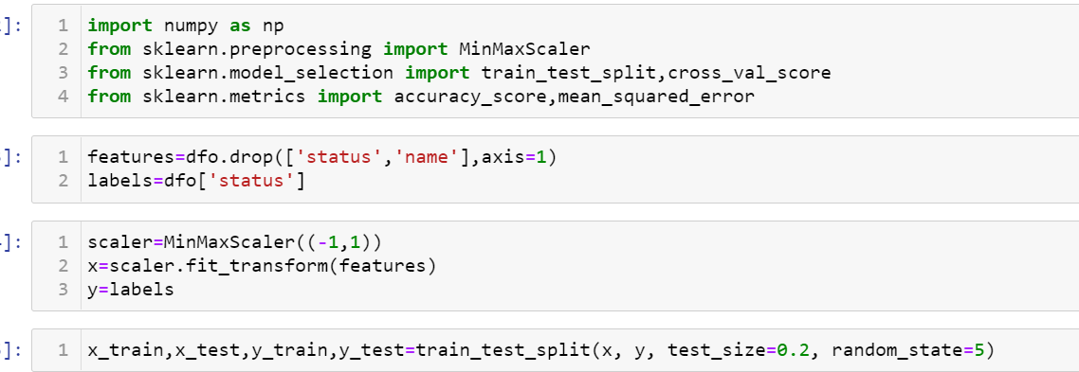
SCALING & SPLITTING

Slide 17
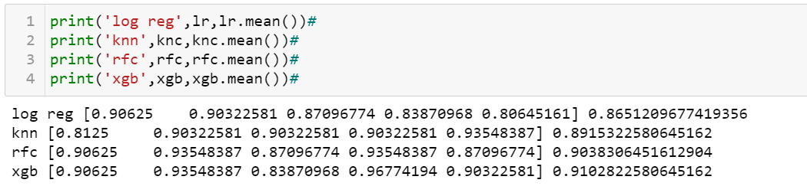
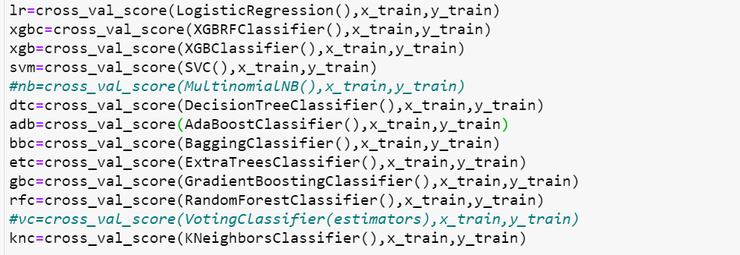

Slide 18
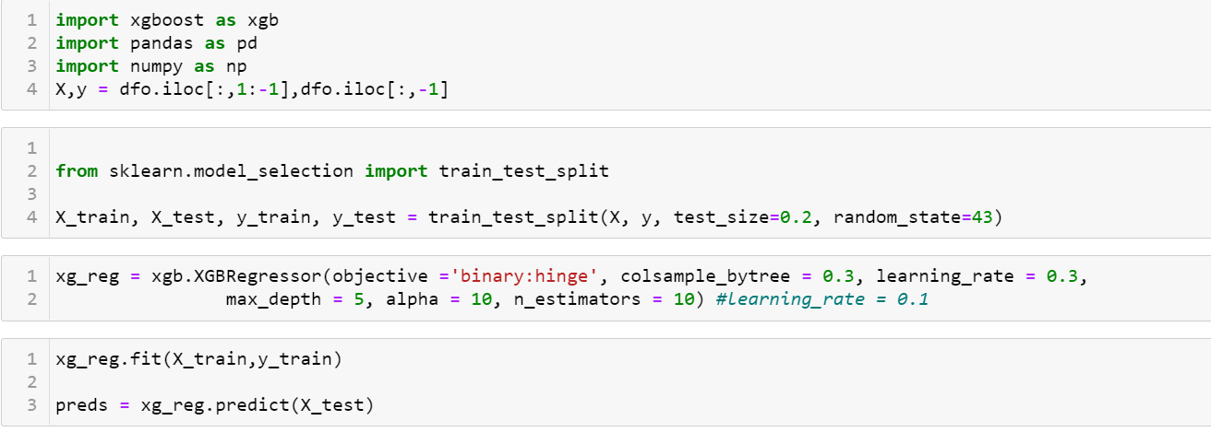
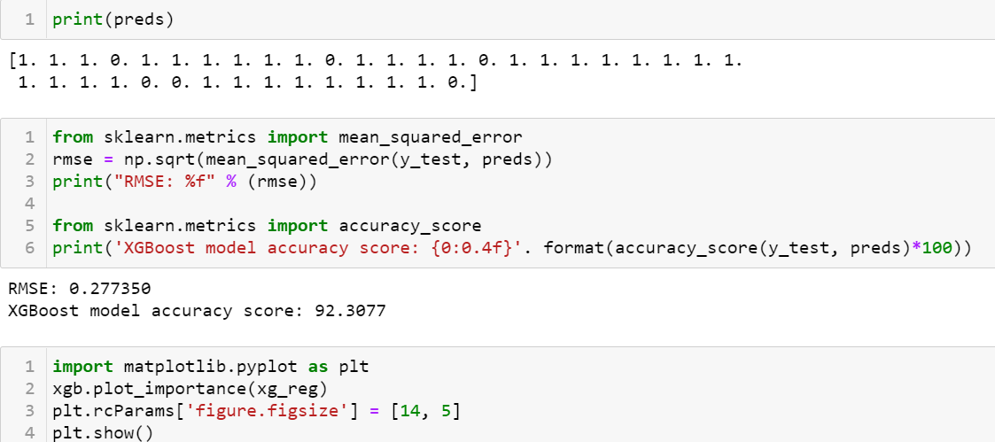

Slide 19
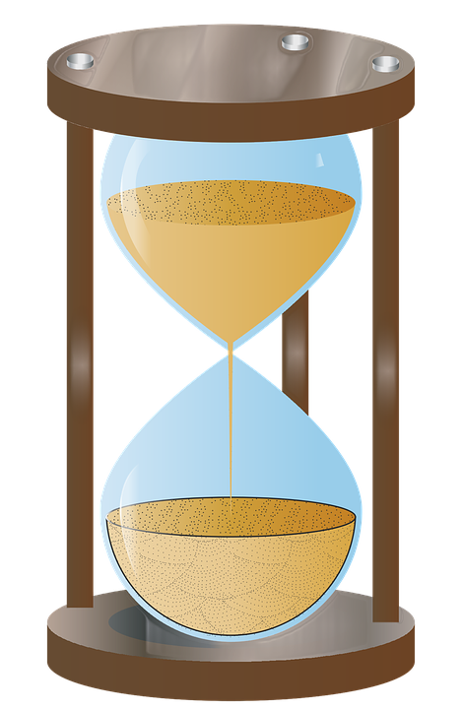
RUNTIME ANALYSIS

Slide 20
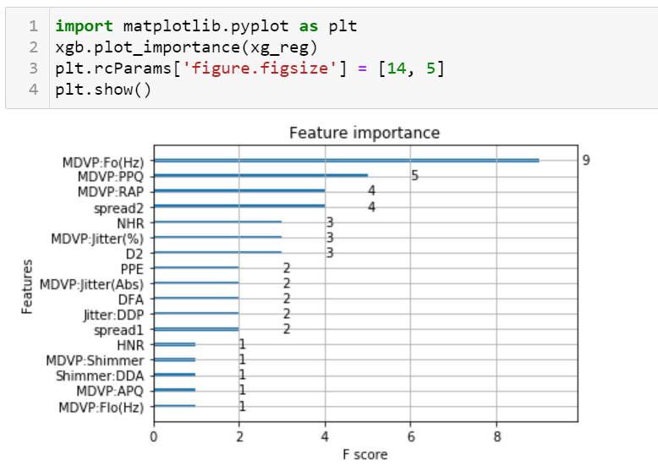

Slide 21
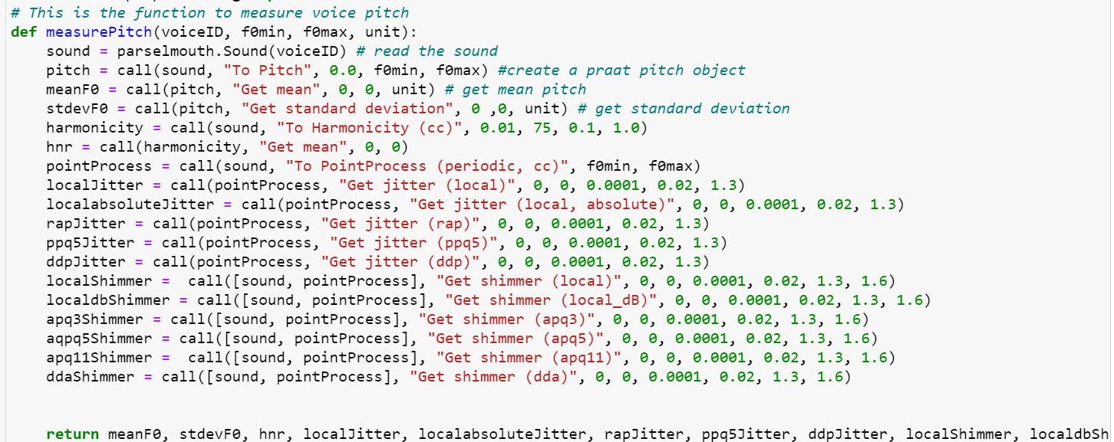
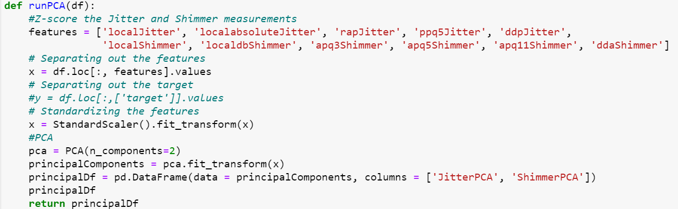

Slide 22
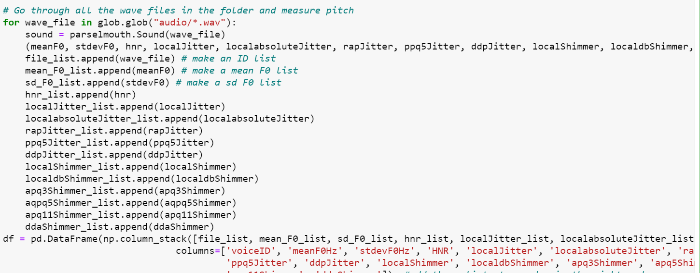
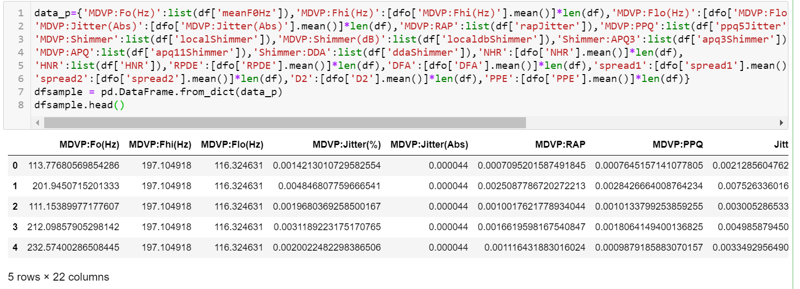

Slide 23
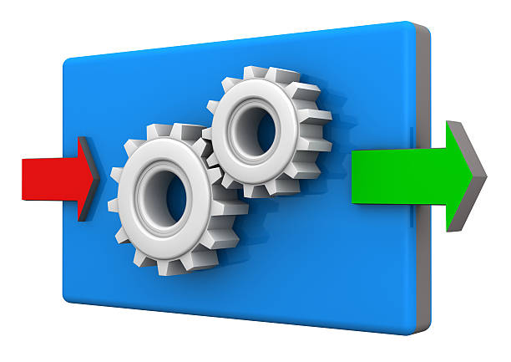
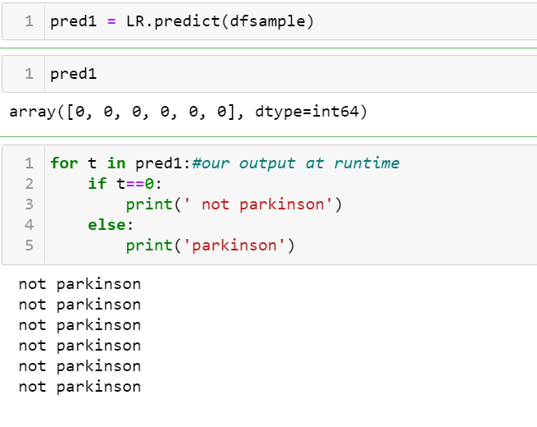
RUNTIME OUTPUT

Slide 24

CONCLUSION
The proposed model could be the first indication in detection of Parkinson.
Hassle free detection
Using Machine Learning we can apply a proactive approach towards detection.
Moreover…
Real Time Voice Analysis for Parkinson Detection.
This could be achieved for feature extraction using python library parselmouth and voice analysis software praat .

Slide 25
FURTHER DEVELOPMENT
Interfacing project with : -
- Website
- Application
Applicability of our project can be increased by taking into account other symptoms.
We would be starting campaigns using social media, to increase awareness about Parkinson.

Slide 26
Hardware used:
Personal Computer
Laptop
Software Used: (language/library)
For Data Analysis: For Machine Learning:
Pandas Scikit-Learn
NumPy
Matplotlib.pyplot

Slide 27
PYTHON LIBRARIES
●NumPy : It's a library for the Python programming language, adding support for large, multi-dimensional arrays and matrices, along with a large collection of high-level mathematical functions to operate on these arrays.
●SkLearn : A free software machine learning library for the Python programming language. It features various classification, regression and clustering algorithms including support vector machines, random forests, k-means etc. and is designed to interoperate with NumPy and SciPy.
●Keras : Its a open source neural network library written in Python. Capable of running on top of TensorFlow. Designed to enable fast experimentation with deep neural networks, its pros being user-friendly, modular, and extensible.
●Matplotlib : A plotting library for the Python programming language and its numerical mathematics extension.

Slide 28
PYTHON LIBRARIES
Os: provides functions for interacting with the operating system. OS comes under Python's standard utility modules. This module provides a portable way of using operating system-dependent functionality.
OpenCV: OpenCV is a huge open-source library for computer vision, machine learning, and image processing. OpenCV supports a wide variety of programming languages like Python, C++, Java, etc.
Pandas: Pandas is an open source Python package that is most widely used for data science/data analysis and machine learning tasks.
Parselmouth: Audio processing library

Slide 29
REFERENCES
https://www.nia.nih.gov/health/parkinsons-disease
https://www.parkinson.org/understanding-parkinsons/what-is-parkinsons
https://archive.ics.uci.edu/ml/datasets/parkinsons
XGBoost: A Deep Dive into Boosting | by Rohan Harode | SFU Professional Master’s Program in Computer Science | Medium
Saunders-Pullman R, Derby C, Stanley K, Floyd A, Bressman S, Lipton RB, et al. Validity of spiral analysis in early Parkinson’s disease. Mov Disord (2008) 23(4):531–7. doi:10.1002/mds.21874
San Luciano M, Wang C, Ortega RA, Yu Q, Boschung S, Soto-Valencia J, et al. Digitized spiral drawing: a possible biomarker for early Parkinson’s disease. PLoS One (2016) 11(10):e0162799. doi:10.1371/journal.pone.0162799
Sisti JA, Christophe B, Seville AR, Garton AL, Gupta VP, Bandin AJ, et al. Computerized spiral analysis using the iPad. J Neurosci Methods (2017) 275:50–4.

Slide 30
THANK YOU

